Slide 1
Docker is software containerization
Platform.
It makes the process of application deployment very easy and efficient and
resolves a lot of issues related to deploying applications

Slide 2
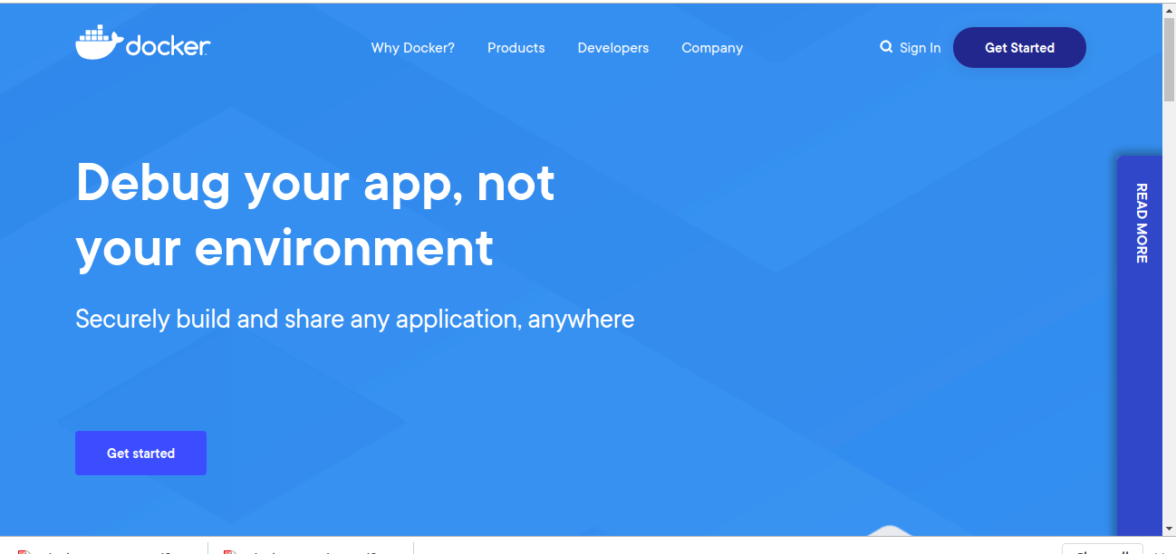

Slide 3
Problems Before Docker
Shipping of Software/Application was not standardised cassed usual issues.
Developers faced issue like Application working in one environment but not in other.
e.g There can be a software wich is updated on Prod but remain same on dev.
Advent Microservice and microservice deployement
Vertual Machines was one of the solution earlier which is costly and time consuming compaired to Docker container

Slide 4
Virtualization VS Containerization
Containers uses Containerization which can be considered as an evolved version of Virtualization One of the popular ways of deploying and scalling application and instances. The same task can also be achieved using Virtual Machines, however it is not very efficient.
What is Virtualization?
Virtualization is the technique of importing a Guest operating system on top of a Host operating system. This technique was a revelation at the beginning because it allowed developers to run multiple operating systems in different virtual machines all running on the same host. This eliminated the need for extra hardware resource. The advantages of Virtual Machines or Virtualization are:
Multiple operating systems can run on the same machine
Maintenance and Recovery were easy in case of failure conditions
Total cost of ownership was also less due to the reduced need for infrastructure

Slide 5
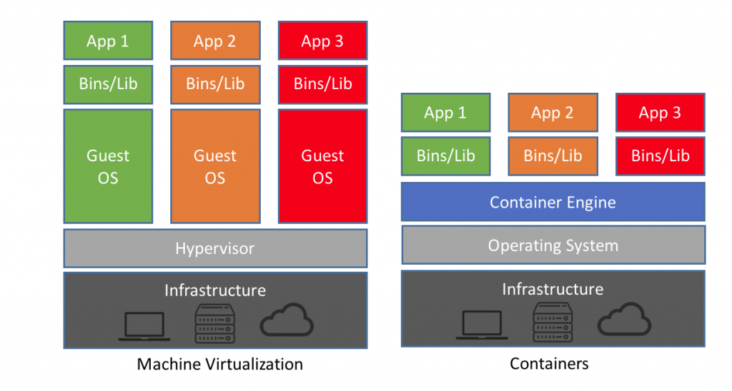
Virtual Machine Vs Container

Slide 6
Benefits of using Docker
Build app only once : An application inside docker container can run on any platform that has docker installed. So there is no need to build and configure app multiple times for different environments.
No worries that the application will not perform the same way it did on testing env
Portability
Version Control
Isolation
Productivity

Slide 7
Containerize and share any application Across any combination of clouds, languages, and frameworks
It’s not possible to explain what Docker is without explaining what containers are, so let’s look at a quick explanation of containers and how they work.
A container is a special type of process that is isolated from other processes. Containers are assigned resources that no other process can access, and they cannot access any resources not explicitly assigned to them.

Slide 8
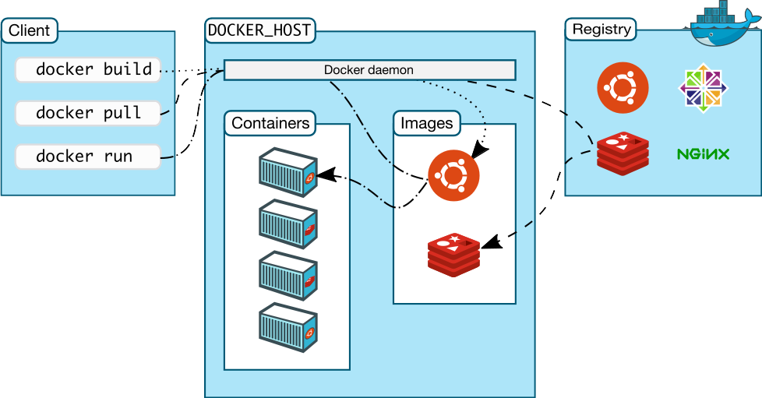
Docker Architechture

Slide 9
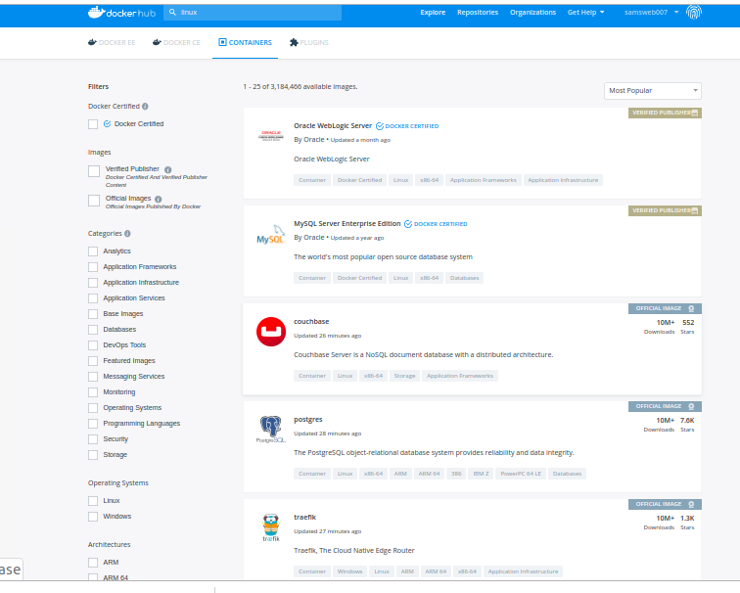
Docker Hub

Slide 10
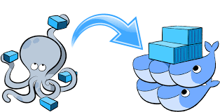
Docker Compose
Docker Compose is a YAML file which contains details about the services, networks, and volumes for setting up the Docker application. So, you can use Docker Compose to create separate containers, host them and get them to communicate with each other. Each container will expose a port for communicating with other containers.
Docker Compose is basically used to run multiple Docker Containers as a single server.
Example:
Suppose if I have an application which requires Node, DB and NPM. I can create one file which would start both the containers as a service without the need to start each one separately. It is really useful especially if you have a microservice architecture.
It is really useful especially if you have a microservice architecture. It can also sequence to operation of running dependent one earlier.

Slide 11
Container Orchestrator And Clustering
Tools to manage, scale, and maintain containerized applications are called orchestrators, and the most common examples of these are Kubernetes and Docker Swarm.
Orchestration tools helps you to manage a containerized application in various types of physical, virtual, and cloud environments.
Docker swarm is Docker’s own container’s orchestration system.

Slide 12
Container Orchestration and Clustering Tools
KUBERNETES
  1. Created by Google
  2. Huge Developer community
  3. Better for large containers (100-1000)
  4. Seting up cluster is challanging and complicated
  5. Automatic scalling based on trafic
  6. Manual configuration for load balancing traffic
  7. Rolling updates
  8. Automatic rollback to previous stable state
DOCKER SWARM
  1. Created and maintained by Docker Inc
  2. Community is not as big as of K8’s
  3. Better for small no of containers
  4. Setting up cluster is simple and require two commands.
  5. Manual scalling needed
  6. Swarm dose auto Load balancing
  7. Rolling update for container
  8. Manual rollback
Docker
Docker
Docker

Slide 13
Container Orchestration and Clustering Tools
KUBERNETES
  2. Huge Developer community
  Better for large containers (100-1000)
  Seting up cluster is challanging and complicated
  Installation and set-up. Docker Swarm is simple to install as compared to Kubernetes.
  Docker Swarm also provides flexibility by allowing any new node to join an existing cluster as either a manager or a worker.
  2. Logging and monitoring
  Docker Swarm is supported for only monitoring with third-party applications. It is recommended to use Docker with Reimann for monitoring
DOCKER SWARM
  Community is not as big as of K8’s
  Better for small no of containers
  Setting up cluster is simple and require two commands.
  installation is manual and it takes serious planning to make Kubernetes up and running.Various 3rd party packages like minikube / kubectl / kubeadm are needed to be installed for the working and development of kubernetes.
  2. Logging and monitoring
  Kubernetes supports multiple versions of logging and monitoring when the services are deployed within the cluster:
  ELK Stack — ElasticSearch, Logstash, Kibana.
  Heapster/Grafana/ Influx for monitoring in the container
Docker
Docker
Docker

Slide 14
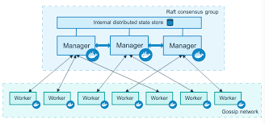
Swarm Cluster
A swarm is a cluster of one or more computers running Docker. It can consist of one or more machines, so you can use swarm functionality on your local machine. With the introduction of swarm mode, Docker received built-in orchestration, clustering and scheduling capabilities.
Node can be Follower, Candidate, Leader state. Process of selection is called Leader Election.
Having the same consistent state across the cluster means that in case of a failure, any Manager node can pick up the tasks and restore the services to a stable state. For example, if the Leader Manager which is responsible for scheduling tasks in the cluster dies unexpectedly, any other Manager can pick up the task of scheduling and re-balance tasks to match the desired state.

Slide 15
Container Orchestration and Clustering Tools
KUBERNETES
  1. Created by Google
  2. Huge Developer community
  Better for large containers (100-1000)
  Seting up cluster is challanging and complicated
  Installation and set-up. Docker Swarm is simple to install as compared to Kubernetes.
  Docker Swarm also provides flexibility by allowing any new node to join an existing cluster as either a manager or a worker.
  2. Logging and monitoring
  Docker Swarm is supported for only monitoring with third-party applications. It is recommended to use Docker with Reimann for monitoring
DOCKER SWARM
  1. Created and maintained by Docker Inc
  Community is not as big as of K8’s
  Better for small no of containers
  Setting up cluster is simple and require two commands.
  installation is manual and it takes serious planning to make Kubernetes up and running.Various 3rd party packages like minikube / kubectl / kubeadm are needed to be installed for the working and development of kubernetes.
  2. Logging and monitoring
  Kubernetes supports multiple versions of logging and monitoring when the services are deployed within the cluster:
  ELK Stack — ElasticSearch, Logstash, Kibana.
  Heapster/Grafana/ Influx for monitoring in the container
Docker
Docker
Docker

